Slide 1
A Comparative Study of Homeless Populations in Texas and California
UTA Data Bootcamp Project 1
Alex, Arle, Beauty, Isha, and Nancy

Slide 2
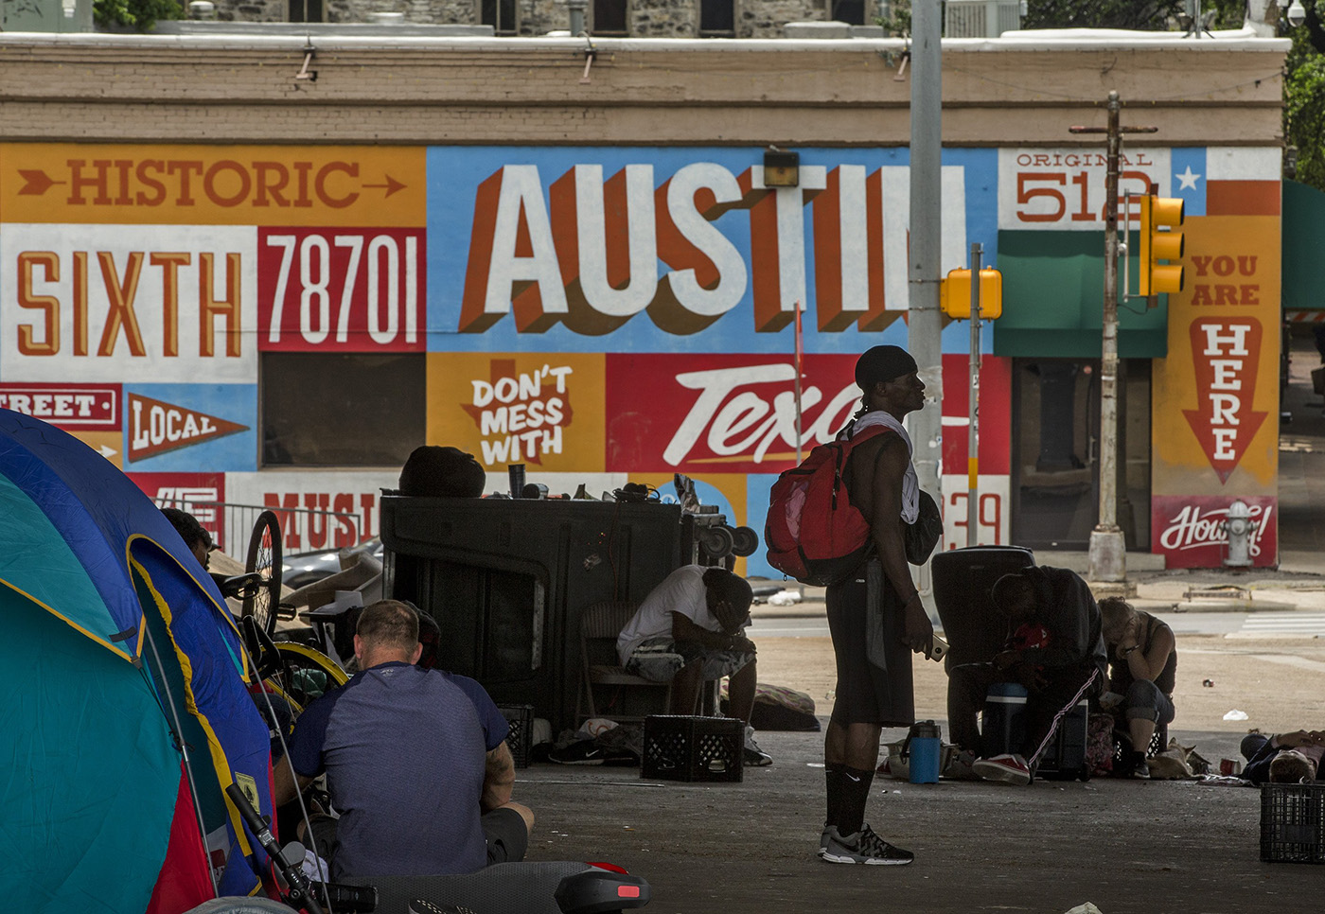
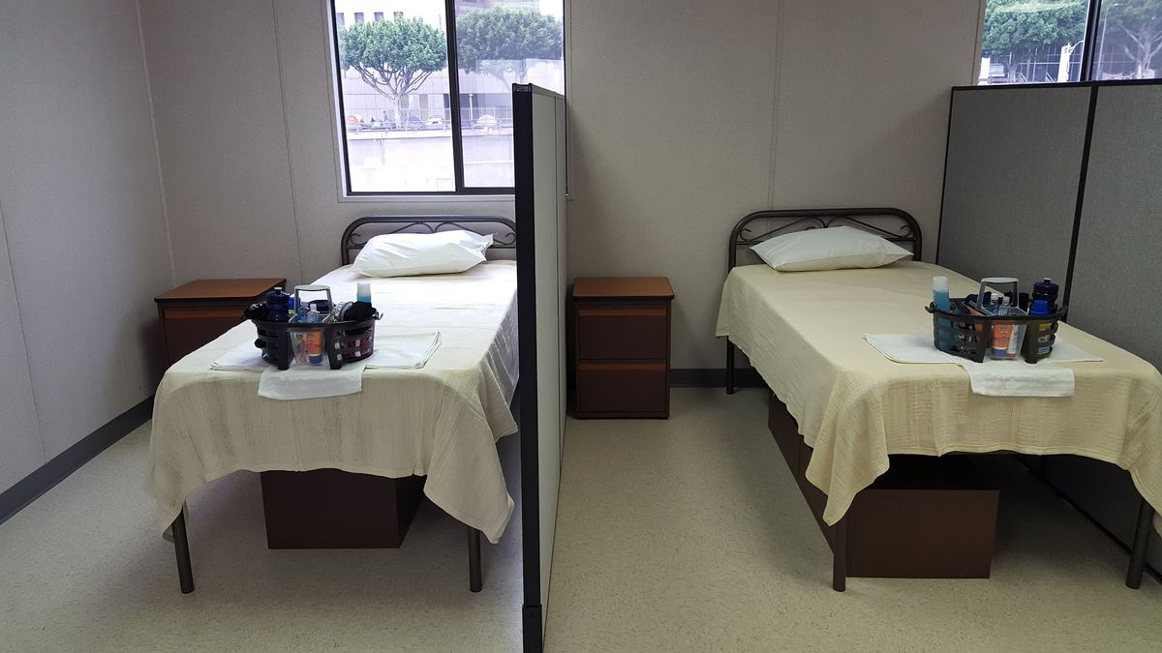
What is Homelessness?
An individual or family who lacks a fixed, regular, and adequate nighttime residence, such as those living in emergency shelters, transitional housing, or places not meant for habitation.
https://soarworks.samhsa.gov/article/definitions-of-homelessness#:~:text=The%20definition%20of%20those%20who,not%20meant%20for%20habitation%2C%20or

Slide 3
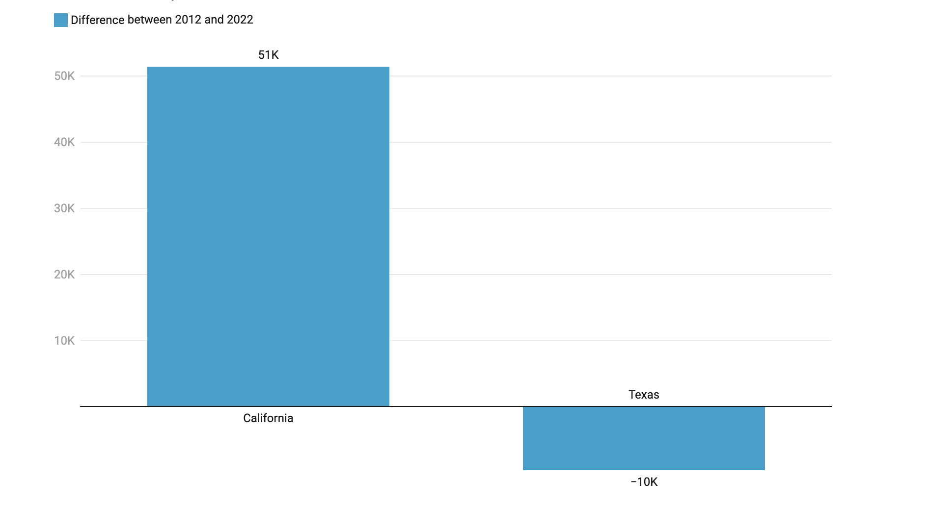
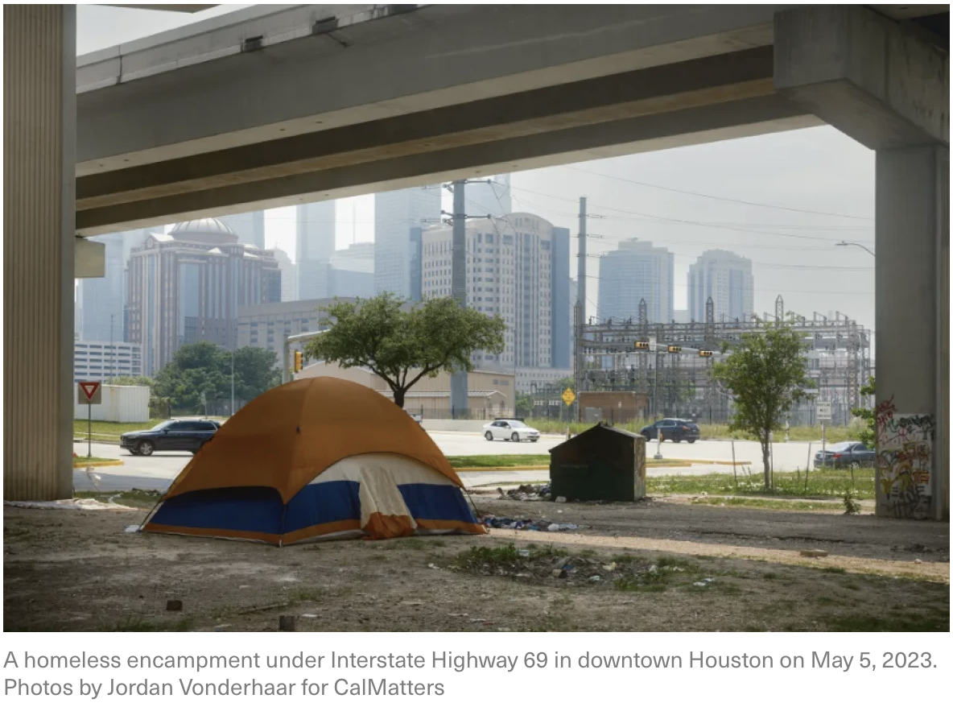
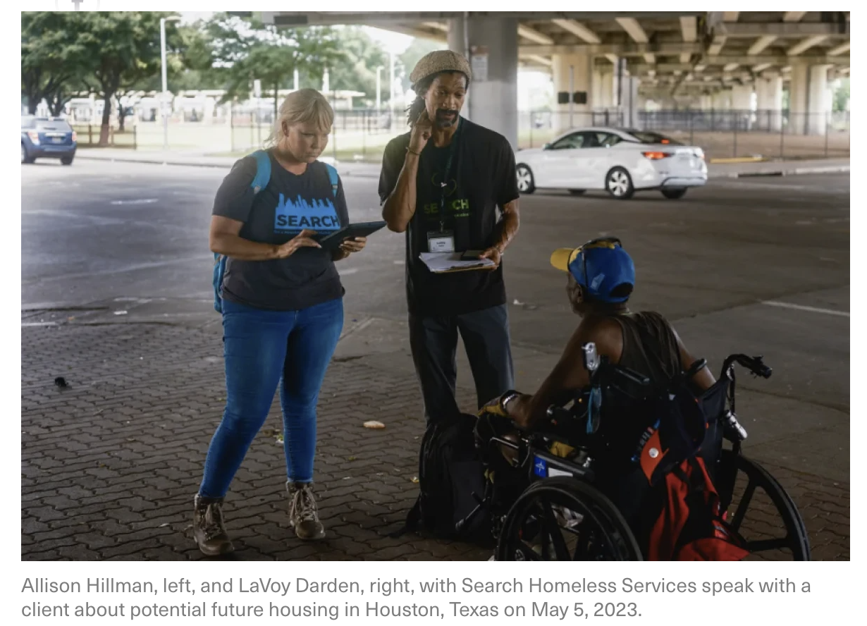
How Texas Shrank Its Homelessness Population — And What It Can Teach California
Between 2012 and 2022, the number of people who are homeless in California increased significantly while the same metric in Texas went down by almost a third.
How Texas Shrank Its Homelessness Population — And What It Can Teach California | LAist

Slide 4
Research Questions
Are some race groups affected by homelessness more than others?
What is the correlation between gender and homelessness?
Does the homeless distribution vary according to age groups?
What is the count of veterans experiencing homelessness?
Overall total homeless population taking advantage of CoC shelters available in the area?

Slide 5
Data Sources
Office of Policy Development and Research (PD&R) - Estimates of Homelessness in the United States
2007 - 2020 Point-in-Time Estimates by CoC - https://www.huduser.gov/portal/sites/default/files/xls/2007-2020-PIT-Estimates-by-CoC.xlsx
2007 - 2020 Point-in-Time Estimates by State - https://www.huduser.gov/portal/sites/default/files/xls/2007-2020-PIT-Estimates-by-state.xlsx
2007 - 2020 PIT Veterans Counts by CoC - https://www.huduser.gov/portal/sites/default/files/xls/2011-2020-PIT-Veteran-Counts-by-CoC.xlsx
Notes:
For our analysis we used three different datasets that were all pulled from the Office of Policy Development and Research (PD&R) which gave us an estimate of the amount of homeless individuals in United States.
Point in time estimates by CoC (continum of care → which in general terms are group/resources available to aid homeless individuals)
Point in time homeless estimates by state
Point in time homeless veterans

Slide 6
Data Clean Up
Uploaded datasets into Jupyter Notebook.
Filtered rows by state (CA and TX).
All years were removed from column names in dataset.
A new column was added to include the year of the corresponding dataset.
New data frames were created to merge state rows, years, and desired columns.
Notes:
To begin our EDA we uploaded our datasets into jupyter notebook.
We were only interested in looking at the homeless individuals in california and texas so we filtered the rows by cells containing Ca and Tx data.
The biggest issue with our data cleaning was that individual datasheets within the workbook had columns named with the year. We solved this issue by creating a new column containing the year and we removed the year from the column names.
Ex. “Overall homeless - Asian, 2020” turned into “Overall homeless - Asian”
Finally we created combined datasets by merging our desired rows states (rows) with our desired columns which were overall/sheltered/unsheltered (race, age, gender, veterans) data.

Slide 7
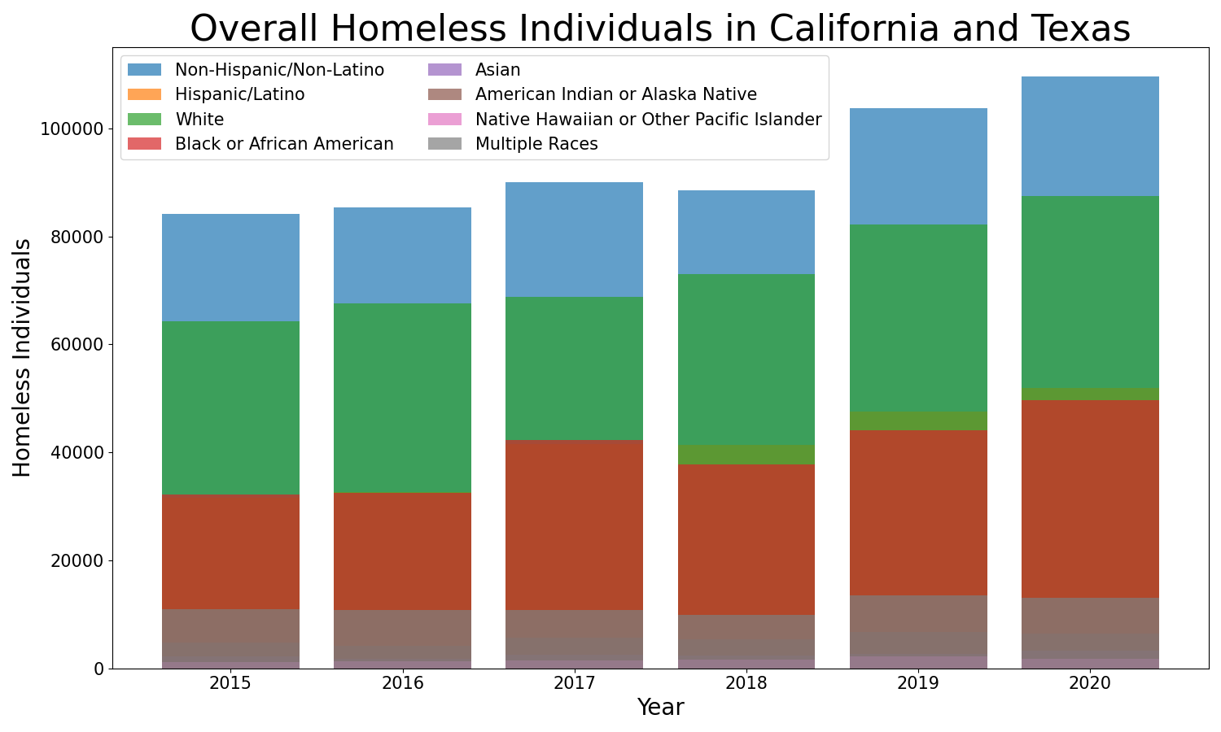
Are some race groups affected by homelessness more than others?
Notes:
The question I focused on was whether or not some races had more homeless individuals than other.
In order to visualize this data I created a bar graph that looked at the overall homeless individuals by major race groups. Based on the data I found that the three races with the highest number of homeless individuals were non-hispanic or non-latino (blue), white (green), and black or african american (red) individuals.

Slide 8
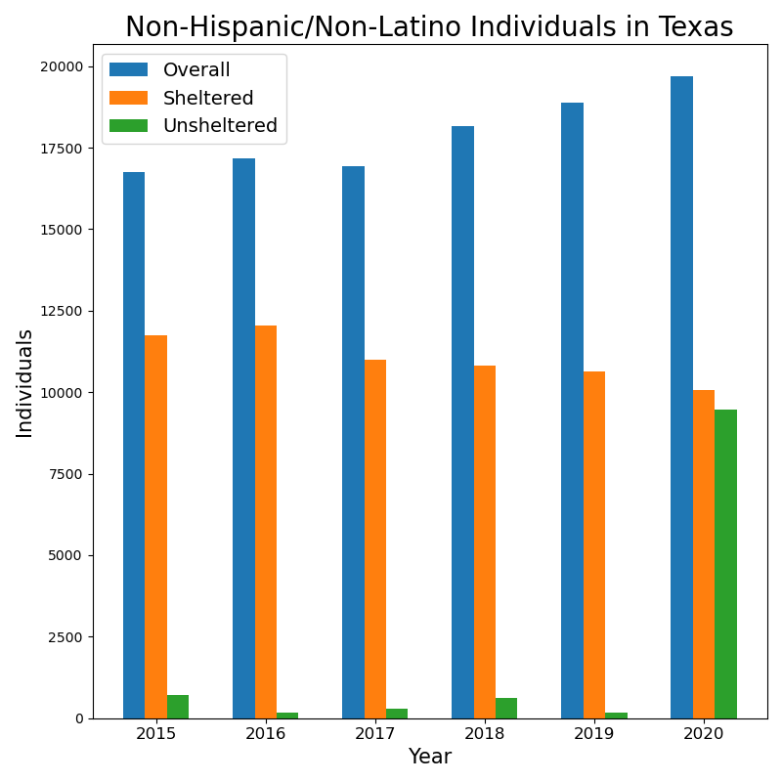
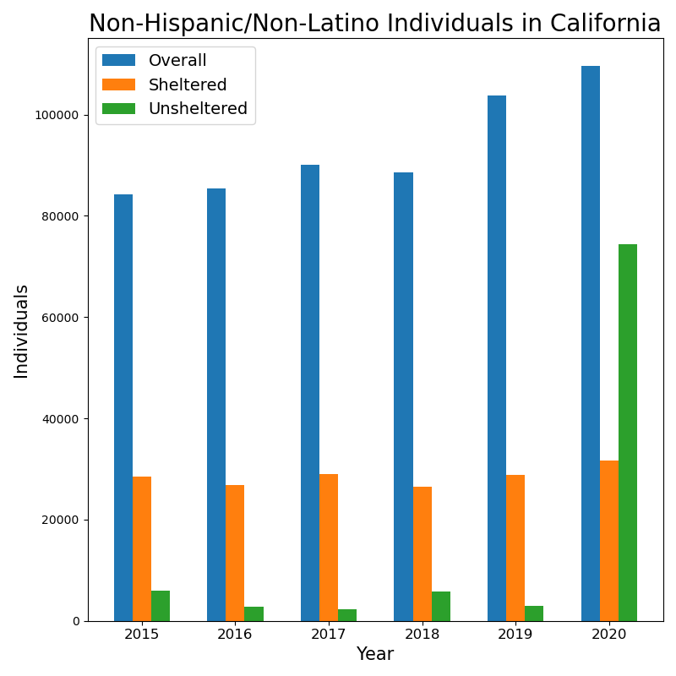
Race
Notes:
To further our analysis for the race demographic I created two more graphs containing the “most affected race” which i determined from the last graph = non-hispanic/non-latino individuals in california and texas. And then I clustered each set of data by overall homeless, sheltered homeless, and unsheltered homeless.
And the general trend that we see regardless of state was the that:
Overall homeless population tends to increase overtime
Sheltered homeless populations end to stay relatively stable (which may indicate that there is a limited number of facilities to house homeless individuals)
There is a significant increase in unsheltered homeless individuals from 2019 to 2020 which is most likely due to the affect of the covid 19 pandemic.

Slide 9
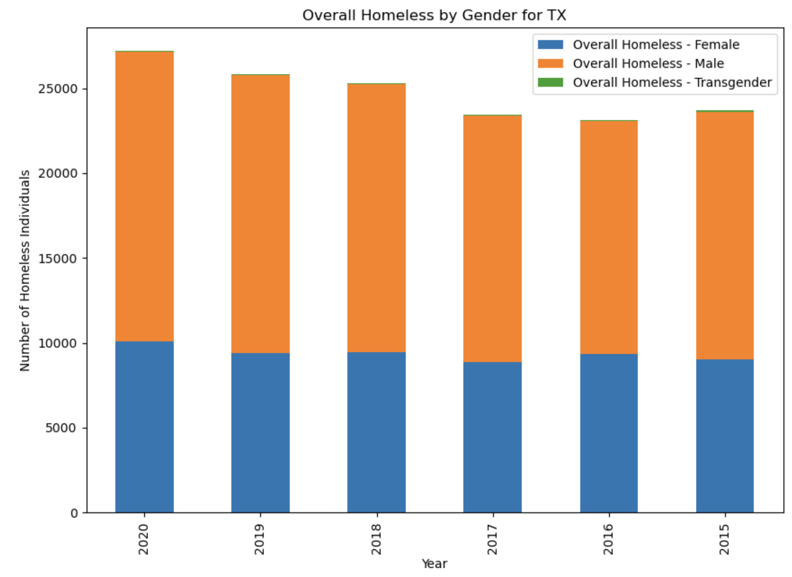
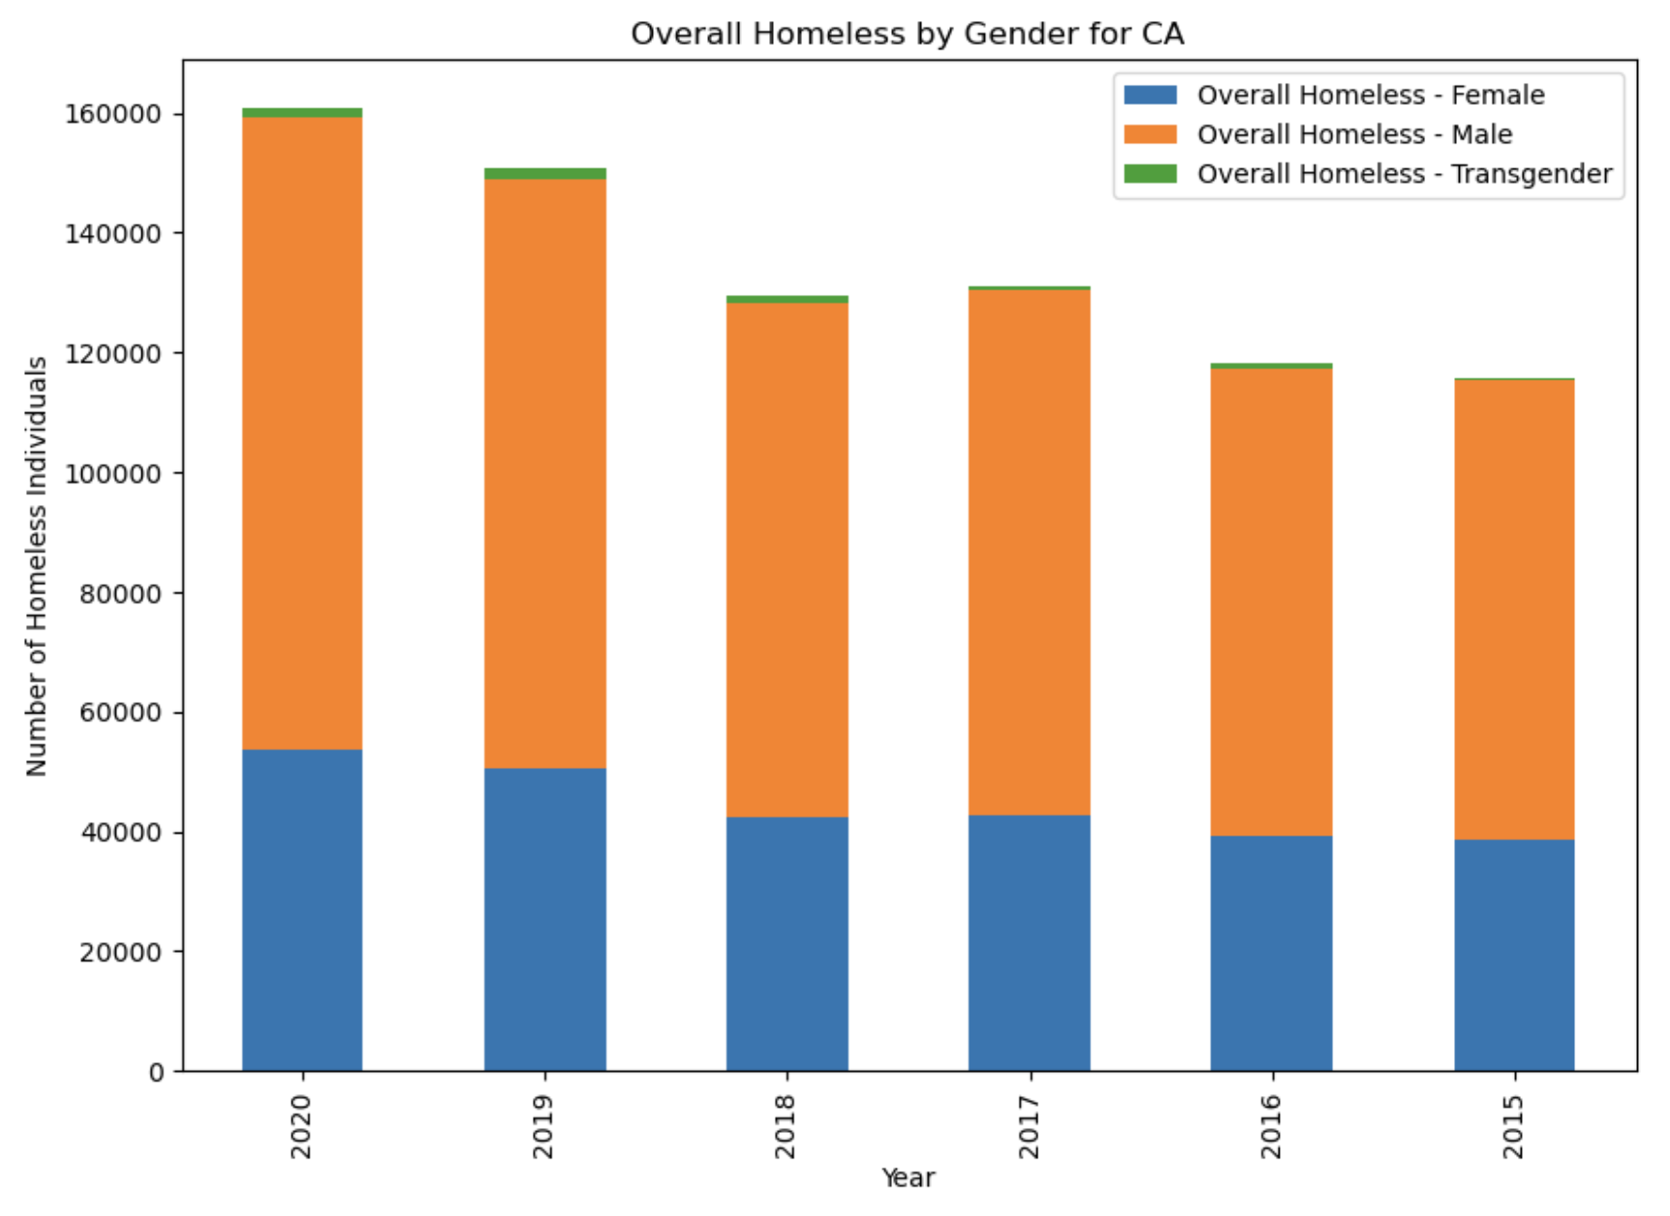
Overall Homeless Comparison for TX/CA
As we can see, the overall male homeless population is greater than the female and transgender. The female population stays pretty close on track thru the years for TX, but it slightly increases each year for CA. Also, the transgender population is much larger for CA compared to TX.

Slide 10
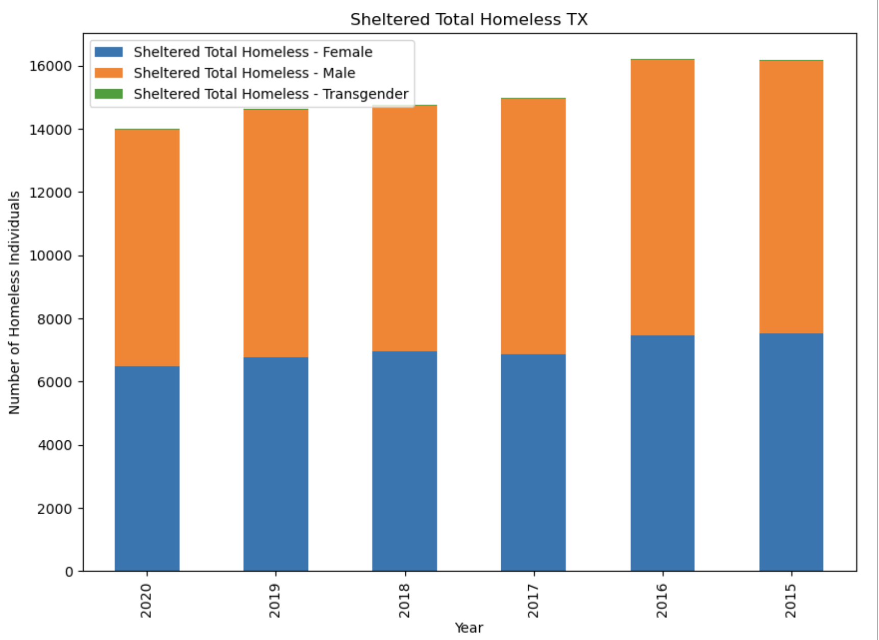
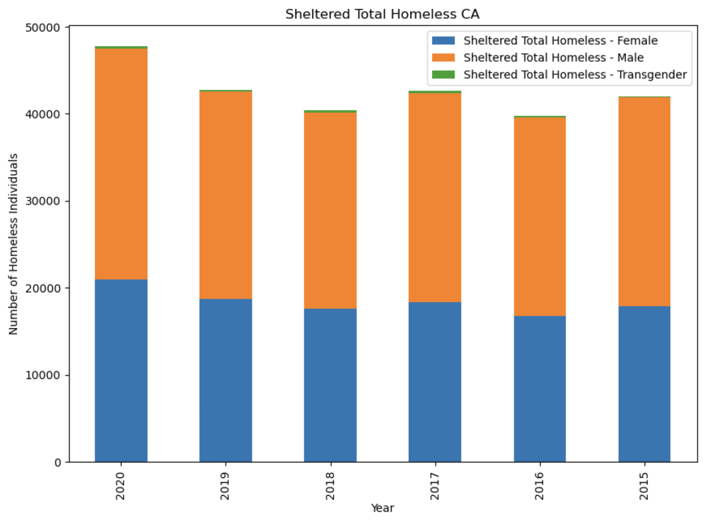
Sheltered Total Homeless Comparison for TX/CA
For TX, the male sheltered population seems to decrease from 2015-2020 for TX, but is sort of unstable for CA. The female sheltered decreases for TX as well, and seems to go up and down for CA, with 2020 having the highest sheltered female total for CA. There is a very small transgender population for Tx, but seems to slightly increase in CA over the years.

Slide 11
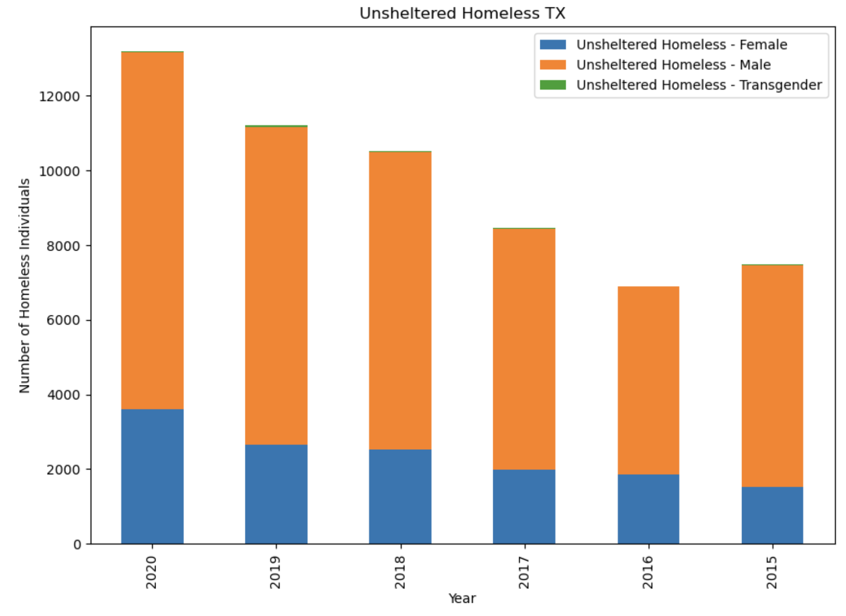
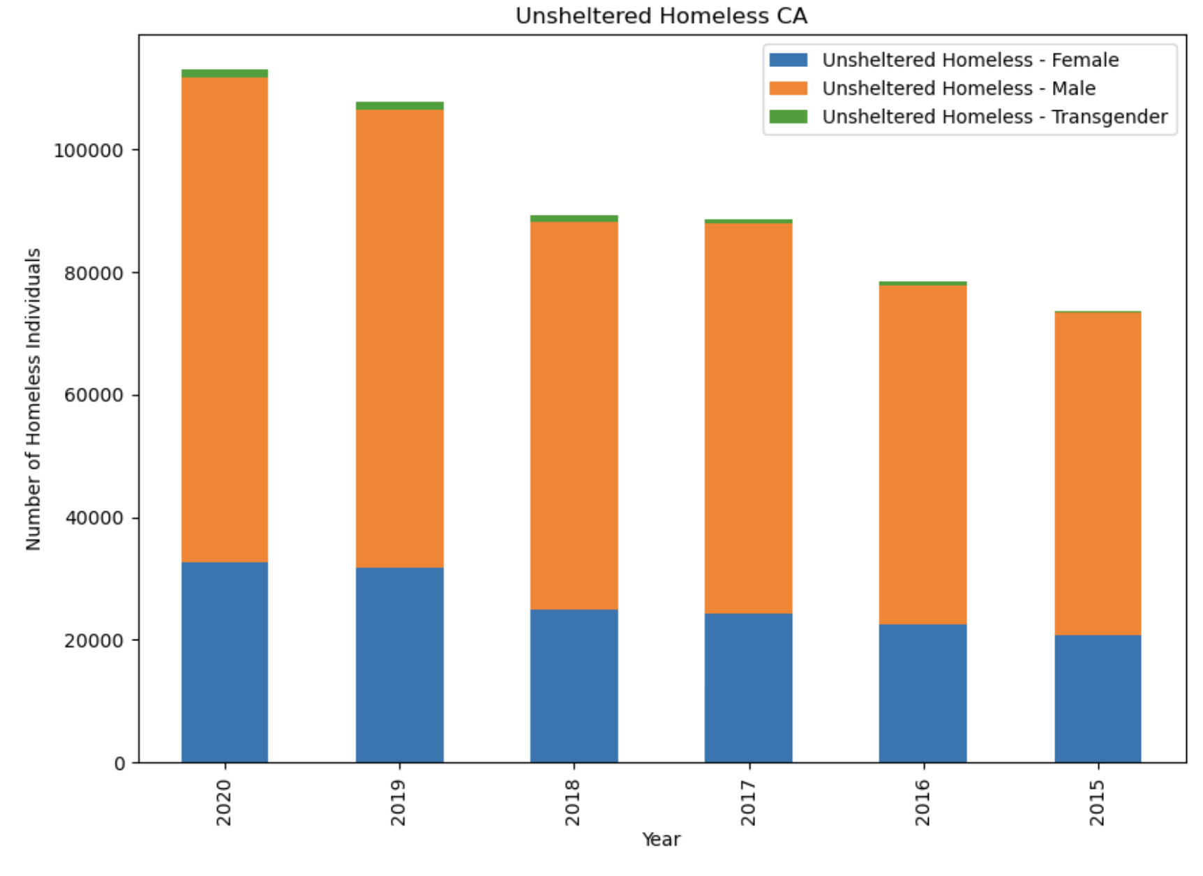
Unsheltered Homeless Comparison for TX/CA
The female unsheltered population is the smallest out of all three variables for TX, but does increase over the years for both TX and CA. The male unsheltered population is also increasing for both TX and CA, with 2020 having the highest total for both graphs. There is a very small population of transgender unsheltered for TX, but for CA it seems to be the largest transgender data population thus far.

Slide 12
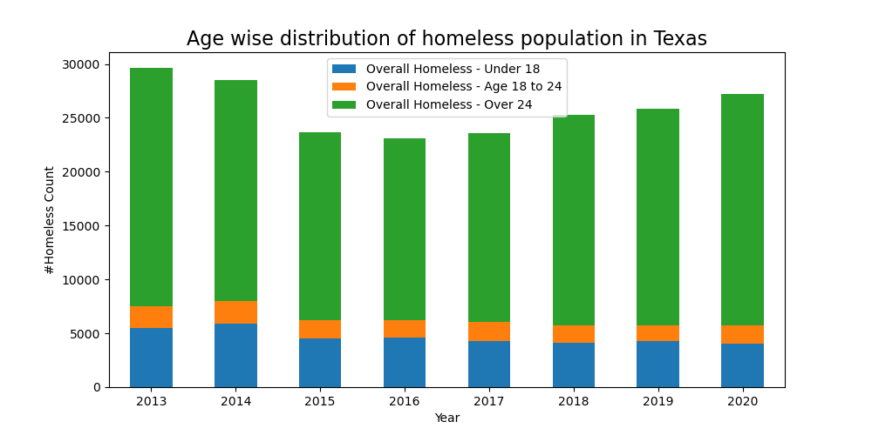
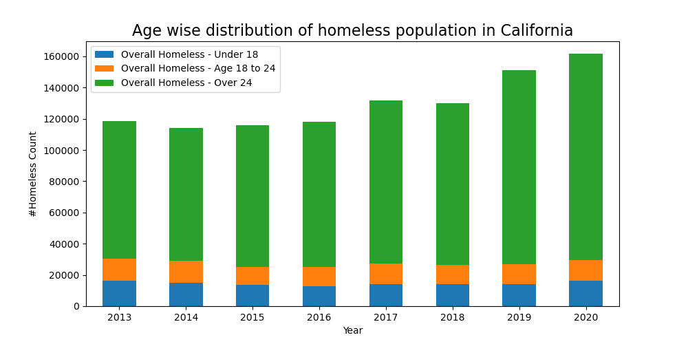
Age wise distribution of homeless population
Homeless population in Texas for age group Under 18 - is gradually decreasing as the years pass by. For 8 to 24 - is approximately same for all 7 years, but can see a small decrease in 2019 and 2020. For Above 24 - is Significantly decreasing for mid years but can see an increase again from 2018-2020.
Homeless population in California for age group - Under 18 - is decreasing in mid years and then there's a rise as move towards 2020. 18 to 24 - is approximately same for all 7 years. For above 24 - is significantly increasing as we move towards 2020

Slide 13
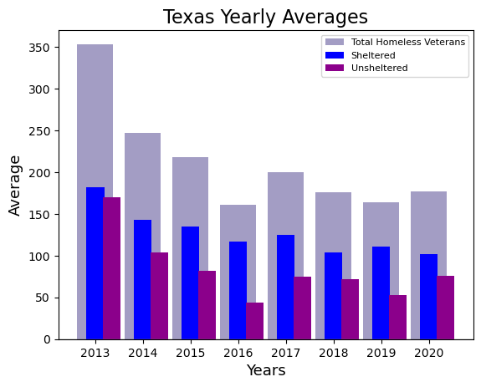
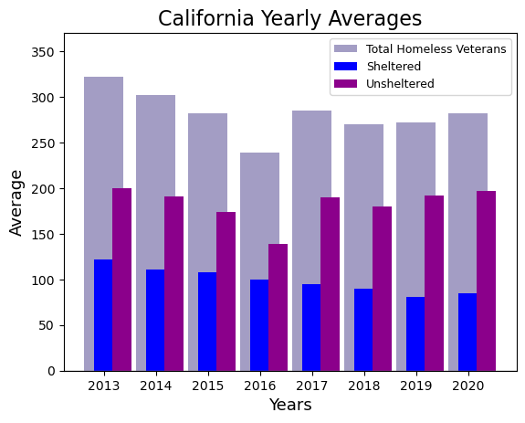
Veterans
Notes:
Overall, the average amount of homeless veterans in Texas decreased by 50%, while California saw an overall decrease of 12%.
Texas had more sheltered than unsheltered veterans throughout the years, whereas California had a greater amount of unsheltered than sheltered veterans.
By comparing the bar graphs for Texas and California, it is clear that Texas had the greater overall drop in homeless Veterans. Texas has an overall 49.86% decrease in homeless veterans, whereas California only had a 12.42% decrease. Texas shows that a significant greater amount of homeless veterans made use of homeless shelters over the years, while California had nearly over 50% of homeless veterans not making use of homeless shelters in their area. This could be due to many factors, such as government funding, or general lack of other resources (such as mental health care/addiction) for the veterans.

Slide 14
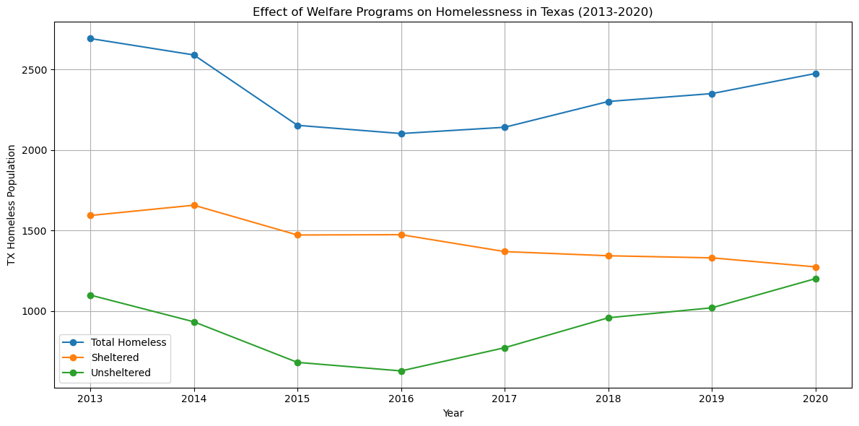
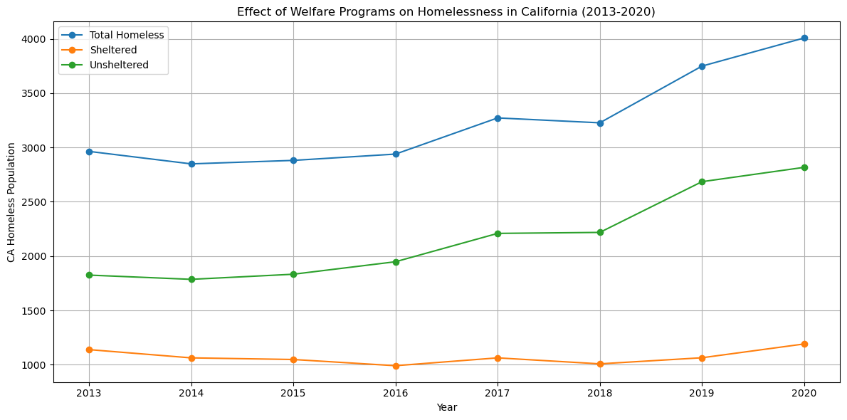
Overall Average Homelessness : TX & CA
Both the average total homeless population & average sheltered homeless has decreased in TX. ……In contrast, the average unsheltered homeless population has slightly increased
Average total homeless population & average unsheltered homeless population has increased significantly. sheltered homeless population shows a slight increase.
Notes:
The average sheltered homeless population in Texas has decreased from 2013 to 2020. **This shows a decreasing trend in the number of homeless individuals in shelters**.
In contrast, the average unsheltered homeless population has slightly increased during that same time. **This indicates a rising trend in people who are homeless or in other places not meant for human habitation**.

Slide 15
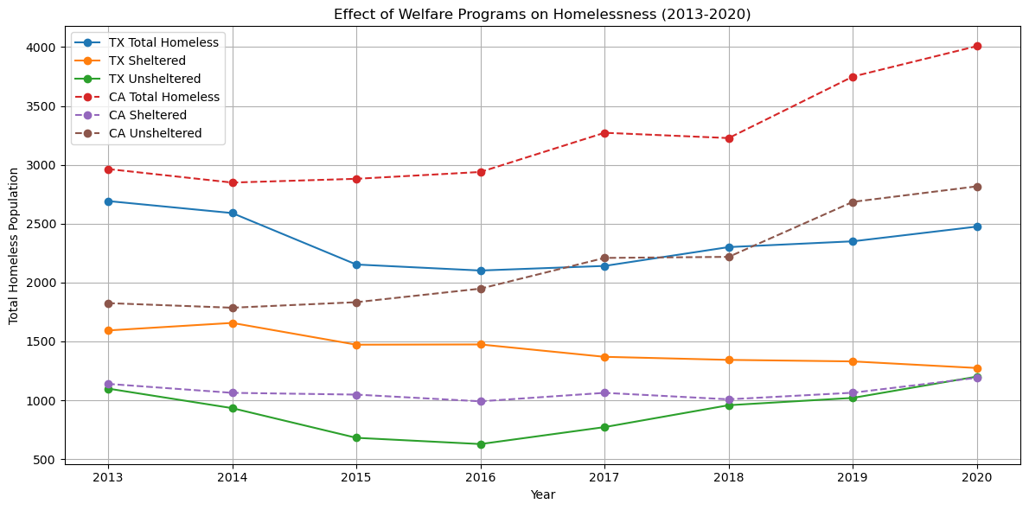
Overall Overage Homelessness : Combined
CA has a much larger and increasing homeless population compared to Texas.
While Texas has experienced a slight decrease, California has seen a significant rise in homelessness.

Slide 16
Analysis
The number of people who are homeless in California increased significantly while the same metric in Texas went down by almost a third between years 2013 to 2020.
While both states experienced fluctuations in homelessness rates, the unsheltered population in California continued to rise
The gender population shows us that males have the highest rate overall for homelessness, female homelessness is gradually increasing over the years, and the transgender population is much larger in California than in Texas.

Slide 17
Limitations
Addition of new variables throughout the years of data collection.
Under representation of homeless individuals within certain populations.
Delayed reporting of homeless individuals.
Sample size
There are only 3 genders listed of the several genders that we have today.
Other variables were not calculated, such as the pandemic or mental health/addictions

Slide 18
References
https://www.huduser.gov/portal/datasets/ahar/2020-ahar-part-1-pit-estimates-of-homelessness-in-the-us.html
https://www.texastribune.org/2023/01/26/texas-homeless-veterans-affairs-va/#:~:text=Texas%20and%20California%20have%20the,the%20beginning%2C%E2%80%9D%20McDonough%20said.
lendingtree.com/home/mortgage/homelessness-study/

